Slide 1
Patenting Artificial Intelligence at the EPO
Patenting Additive Manufacturing (AM)
Pia Björk
European Patent Academy
19 September 2019

Slide 2
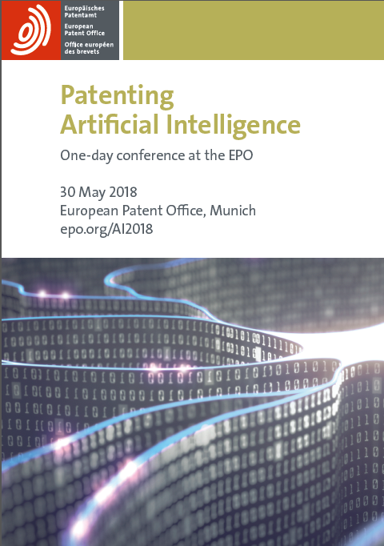
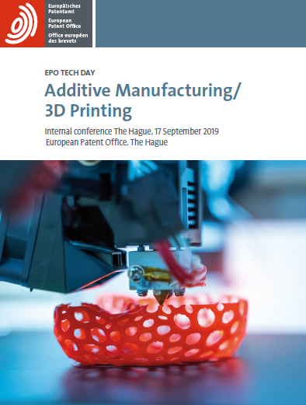

Slide 3
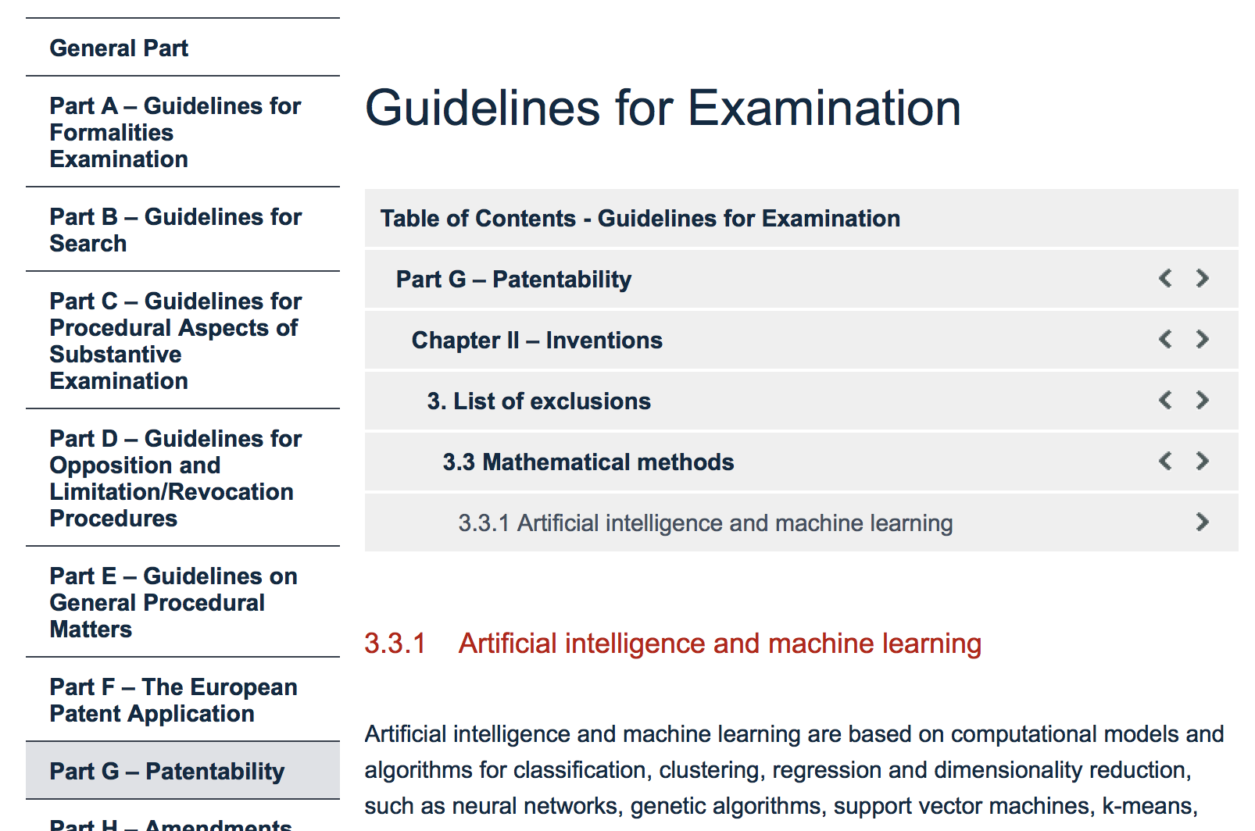
The patentability of AI at the EPO: an established and systematic approach
Guidelines for Examination
in the EPO:
Section G-II, 3.3.1
“Artificial intelligence and machine learning”
(as of 1/11/2018)

Slide 4
Agenda
EPO’s two hurdles approach – technical character
Dimension 1: specific technical implementation
Dimension 2: technical application
Examples from AI conference
Cartography of Additive manufacturing (AM)
Summary

Slide 5
The EPO's established "two-hurdles" approach
1st hurdle: Eligibility / Technical character (Art. 52(1))
  Established without reference to prior art
  Goal: To avoid the exclusions (Art. 52(2): programs, mathematics, algorithms, mental act ... "as such" (Art. 52(3))
  Usually easy to pass: "computer-implemented method", ...
  Often: Mixed-type inventions (GL G-VII, 5.4)

Slide 6
The EPO's established "two-hurdles" approach
2nd hurdle: Technical purpose? (Art. 52(1), 56)
  Is a technical problem solved by technical means?
  Non-technical features (algorithmic/mathematical) can contribute to technical character in combination with technical features in the context of the invention
The question remains: how can an algorithmic feature contribute to the technical character?
Notes:
Describe concrete technical application(s)
not mere mention of potential fields of application
Provide sufficient information to meet the requirements of Art. 83 EPC in respect of these technical applications (otherwise see T1392/06)
what is the concrete technical problem in this application?
how is this problem concretely reduced to the (generic) mathematical problem which can be solved by the mathematical algorithm?
e.g. for Ax=b: what do A, x and b represent in the technical application and how are A and b obtained?
Check carefully the details of the mathematical algorithm
errors may easily lead to an Art. 83 / Art. 123(2) trap
Describe the algorithm at different levels of abstraction to provide support for intermediate generalisations (Art. 123(2) EPC)

Slide 7
Contribution to the technical character: 2 dimensions
Two dimensions:
By being adapted to a specific technical implementation
By its application to a field of technology
Question: Do(es) the AI and ML Method (steps) contribute to the Technical Character of the Invention?

Slide 8
Agenda
EPO’s two hurdles approach – technical character
Dimension 1: specific technical implementation
Dimension 2: technical application
Examples from AI conference
Examples from scoping workshop for AI conference
Summary

Slide 9
Dimension: Specific technical implementation
Claim must be directed to a specific technical implementation:
AI algorithm is specifically adapted for that implementation
AI design motivated by technical considerations of the internal functioning of the computer
Question: Do(es) the AI and ML Method (steps) contribute to the Technical Character of the Invention?

Slide 10
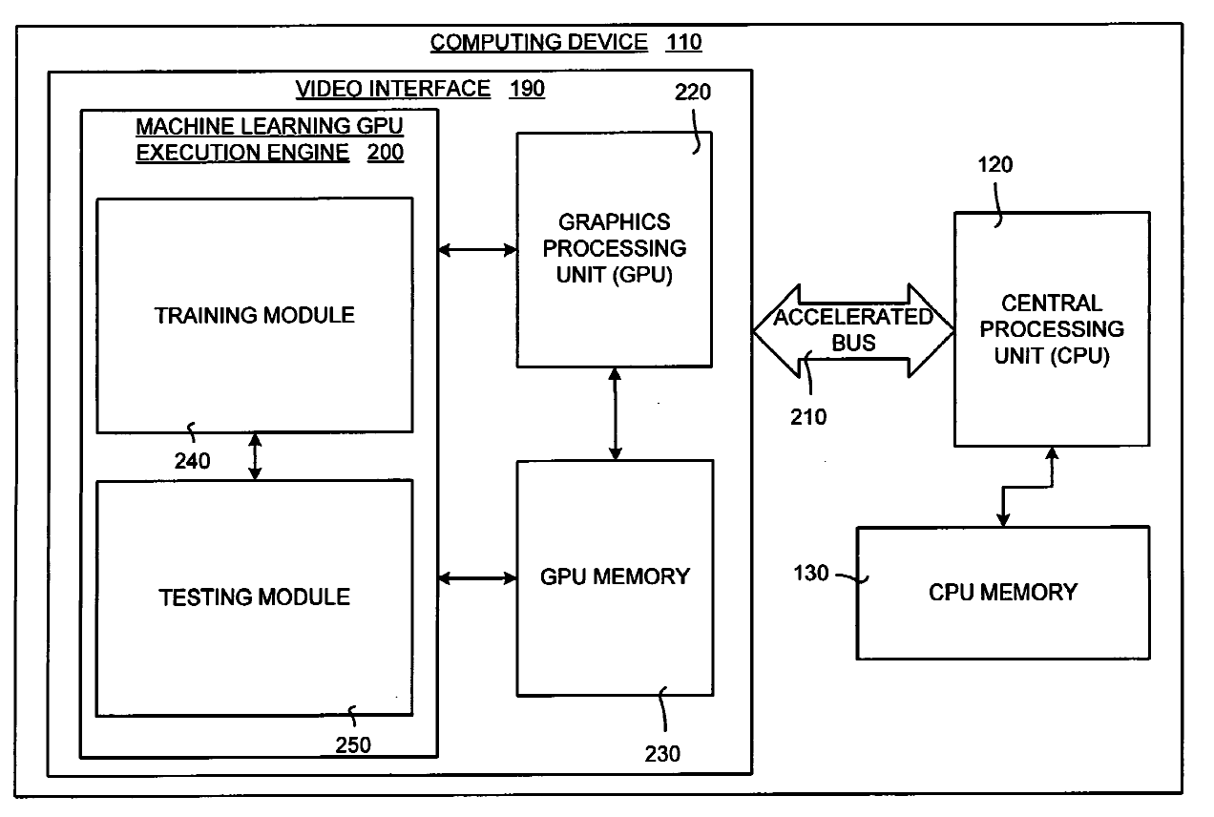
Dimension: Specific technical implementation
Example:
Using the GPU during certain phases of the artificial neural network training process
Notes:
GPU: graphical processing unit

Slide 11
Dimension: Specific technical implementation
Examples:
Deep NN convolutions mapped to GPUs
CPU-GPU training
But it is usually not sufficient:
To claim a generic technical implementation
That an abstract algorithm is more efficient than in the prior art
Question: Do(es) the AI and ML Method (steps) contribute to the Technical Character of the Invention?

Slide 12
Agenda
EPO’s two hurdles approach – technical character
Dimension 1: specific technical implementation
Dimension 2: technical application
Examples from AI conference
Cartography of Additive manufacturing (AM)
Summary

Slide 13
Dimension: Technical application
Yes, to the extent that, in the context of the invention, it serves a technical purpose:
The technical application, i.e. to solve a technical problem in a
field of technology
The technical purpose must be specific, not "controlling a technical system"
Question: Do(es) the AI and ML Method (steps) contribute to the Technical Character of the Invention?

Slide 14
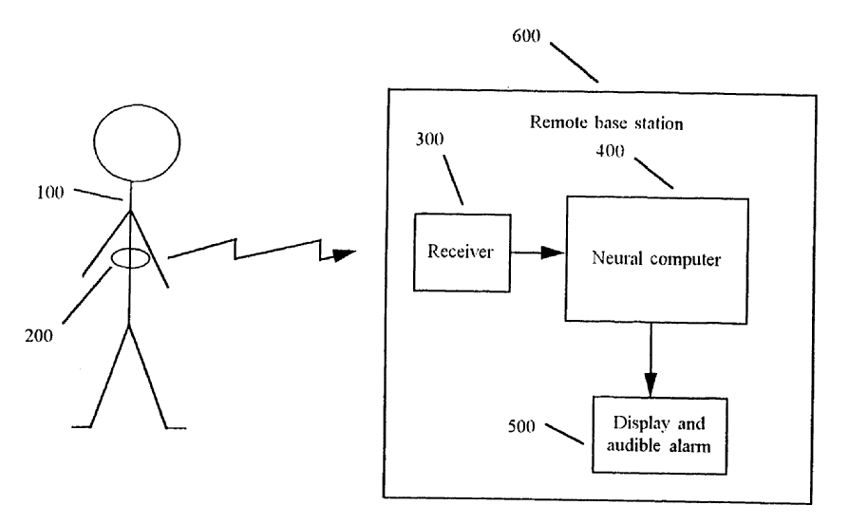
Dimension: Technical application
Example:
Use of Neural Networks in heart monitoring apparatus for identifying irregular heartbeats

Slide 15
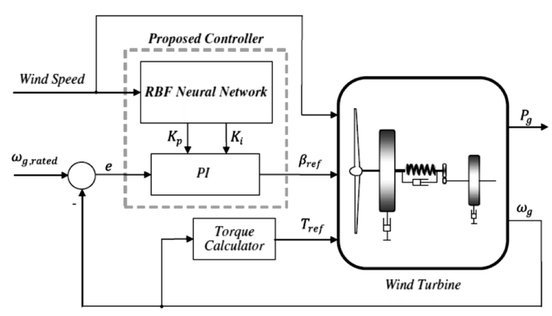
Dimension: Technical application
Example:
Method for controlling a turbine using a neural network
Notes:
EP2801000 (B1)

Slide 16
Agenda
EPO’s two hurdles approach – technical character
Dimension 1: specific technical implementation
Dimension 2: technical application
Examples from AI conference
Cartography of Additive manufacturing (AM)
Summary

Slide 17
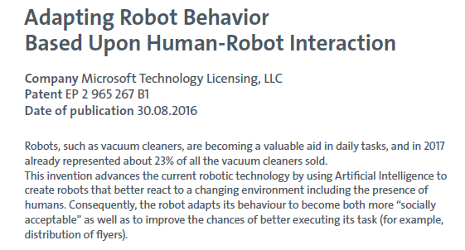
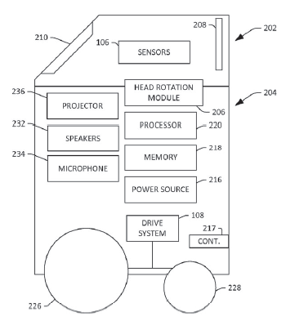
Example from AI conference poster session

Slide 18
Granted claim 1 of EP2 965 267
1. A method of automatically adapting behavior of a mobile robotic device to increase a likelihood that the mobile robotic device will complete a task involving interaction with a human successfully, wherein a successful completion of task comprises (...)
7. A mobile robot comprising:
first and second sensors
...
- executable program instructions... causes the system to perform a method of automatically adapting behavior of a mobile robotic device ...

Slide 19
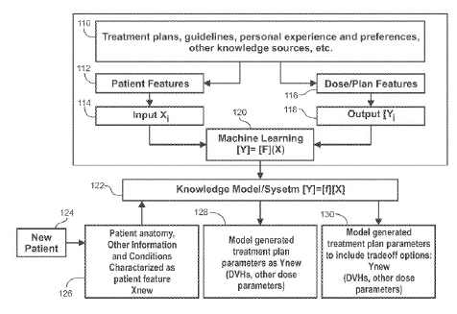
Radiation therapy with the support of AI systems -EP3010585 (Duke University)
Notes:
Radiation therapy with the support
of artificial intelligence systems
Radiation therapy of cancer requires meticulous planning so that the tumour is
destroyed while neighbouring organs are spared. This task is inherently complex
and time-consuming, even for powerful computing systems.
Artificial Intelligence systems reduce considerably planning time while assuring
safer and more effective treatment, using information regarding already treated
cases as well as the current patient data. Further conditions may as well be added,
such as mechanical constraints of the treatment equipment.
Thus, therapy plans can be created individually for each patient while profiting from
the knowledge acquired previously

Slide 20
Granted claim 1 of EP3010585 (Duke University)
1. A method comprising: at a processor and memory:
receiving data based on patient information and geometric characterization (...)
generating, based on the data and a predictive model obtained from a plurality of prior clinical cases of other patients, a first set of radiation treatment planning parameters for the patient;
generating, based on the data and the predictive model (...)
presenting the first and second radiation treatment planning parameters via a user interface.
Notes:
Also claiming a system

Slide 21
Agenda
EPO’s two hurdles approach – technical character
Dimension 1: specific technical implementation
Dimension 2: technical application
Examples from AI conference
Cartography of Additive manufacturing (AM)
Summary

Slide 23
Additive Manufacturing (AM) cartography
Polymers
Control & monitoring
Metals & alloys
Materials
Apparatus & processes
ICT & infrastructure
Ceramics
Energy source
Biomaterials
AM
AM technologies
Applications
Transportation
Tooling
Health & medical
Food
Energy
Electronics
Consumer goods
Construction

Slide 24
Fast growth in all core fields of AM
Number of applications related to the three main AM technology fields filed with the EPO, 1990-2018

Slide 25
Agenda
EPO’s two hurdles approach – technical character
Dimension 1: specific technical implementation
Dimension 2: technical application
Examples from AI conference
Examples from scoping workshop for AI conference
Summary

Slide 26
Summary
Assessment of technical contribution: 2 dimensions
Increase in mixed type applications across technical fields
Inventive step – technical effect
Clarity issues
Additive manufacturing: future of manufacturing?
Notes:
Inventive step: Comvik approach; non-tech features can provide restrictions but do not contribute to inv step as such
JPO considers both tech and non-tech features when assessing inv step

